Slide 1

MSK Simulation Case Scenarios
London Metropolitan University
Date: 19th Feb 2026
Time: 14:00 – 17:00
Lead: Ms. Ifeoma Nwosu, Specialist Physiotherapist

Slide 2
Welcome & Introduction
Time
Session
Case Study / Activity
14:00–14:10
Welcome & Introduction
Session overview
Aim & Focus
MSc expectations
• Safety-first reasoning
• “Treat vs Do Not Treat” mindset
• NHS outpatient realism
Teaching Method: Tutor-led briefing

Slide 3
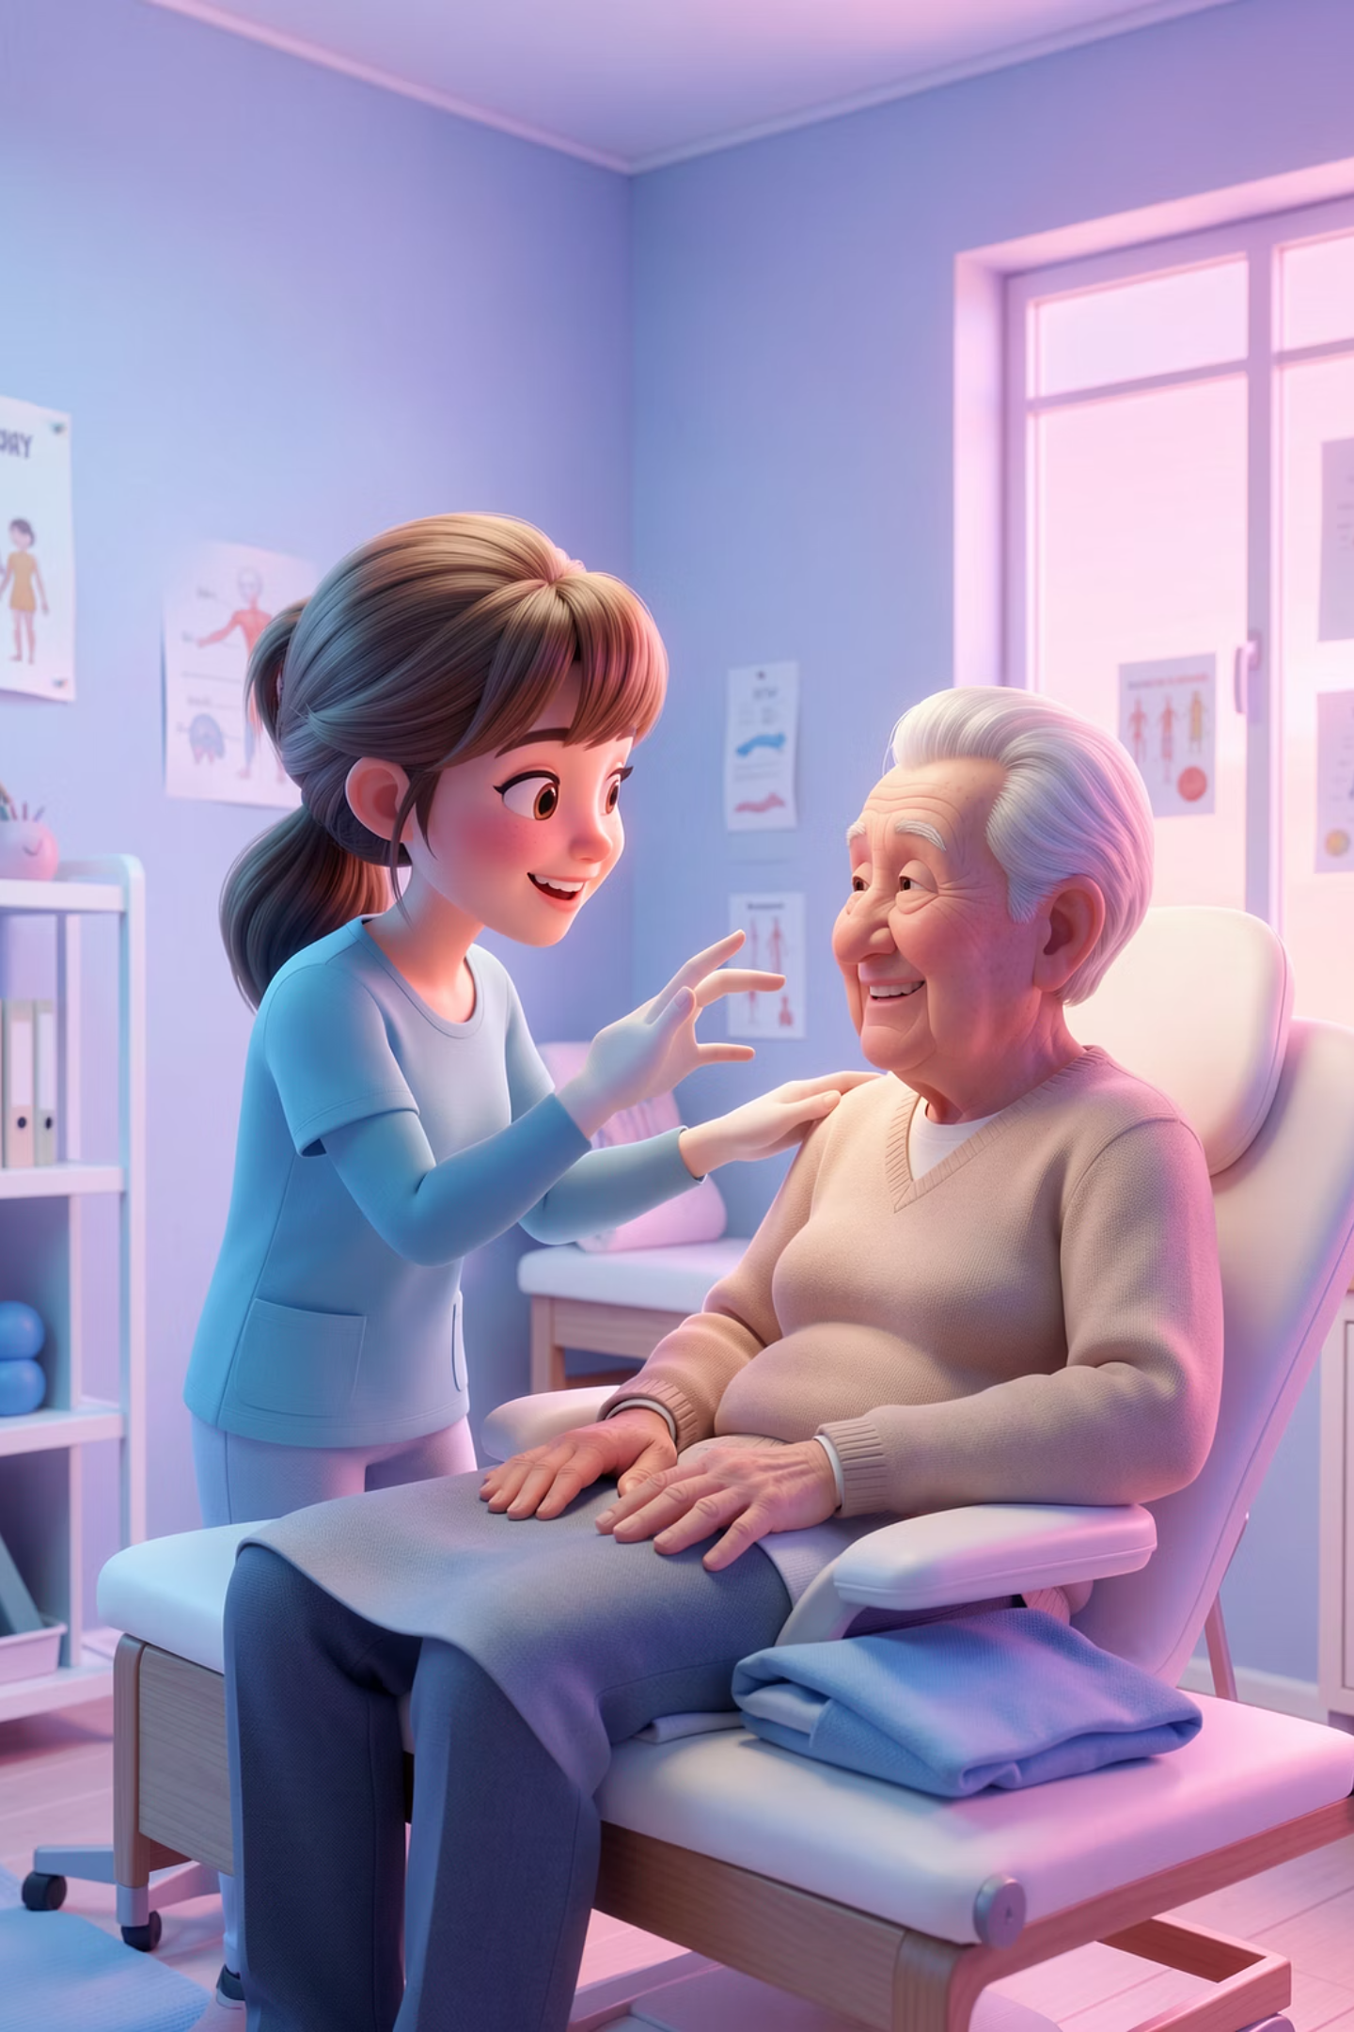
Simulation Case 1 & Debrief
14:10–14:30
14:30–14:40
Simulation Case 1
Debrief 1
Older Adult LBP + Cancer History
Case 1 reflection
Red flags
Spinal pathology, safety-first MSK
Safety thresholds
Escalation pathways
Documentation & medico-legal reasoning
Teaching Method: Simulation + peer observation
Teaching Method: Facilitated debrief

Slide 4
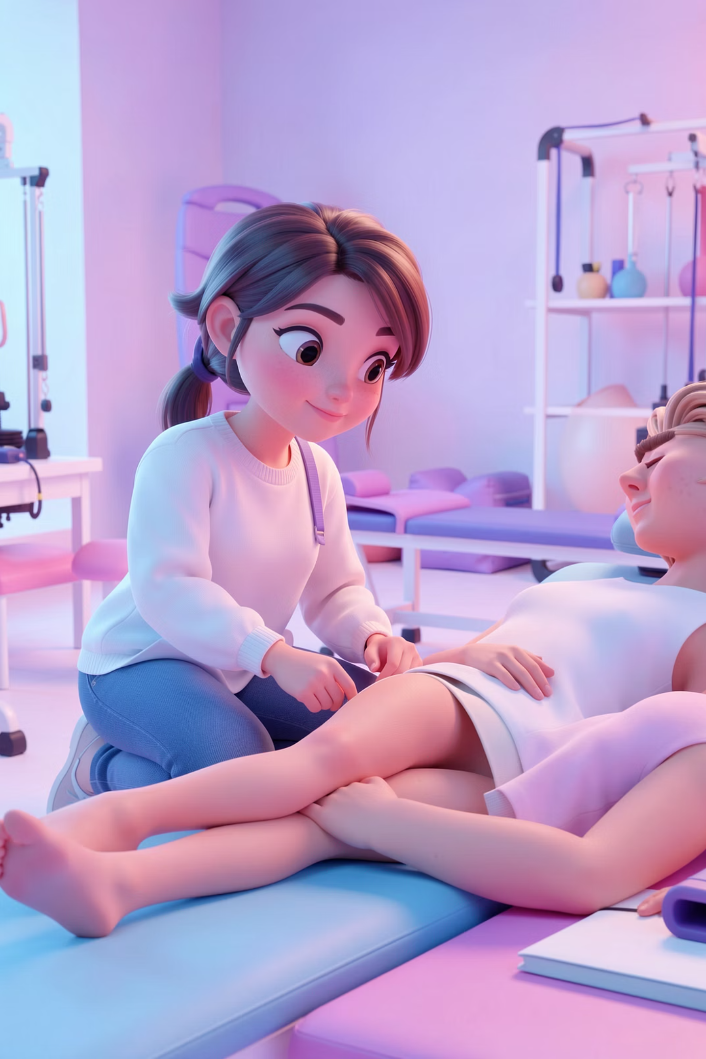
Simulation Case 2 & Debrief
14:40–15:00
15:00–15:10
Simulation Case 2
Debrief 2
Radicular Leg Pain: Root vs Peripheral Nerve
Case 2 reflection
Explaining diagnosis to patients
Avoiding over-medicalisation
Clinical reasoning clarity
Neuroanatomy, root vs peripheral nerve
Clinical reasoning without imaging
Teaching Method: Group discussion
Teaching Method: Simulation + guided questioning

Slide 5
Break & Simulation Case 3
1
15:10–15:30
Break
2
15:30–15:50
Simulation Case 3
Neck & Arm Pain: Radiculopathy vs Myelopathy
UMN vs LMN signs
Cervical radiculopathy
Myelopathy
Shoulder
Teaching Method: High-risk simulation
3
15:50–16:00
Debrief 3
Case 3 reflection
"Treat vs Do not treat" scenarios
Communicating urgency
Scope of practice
Teaching Method: Tutor-led debrief

Slide 6
Simulation Cases 4 & 5 with Wrap-Up
01
02
16:00–16:20 | Simulation Case 4
16:20–16:30 | Debrief 4
Persistent & Inflammatory Low Back Pain
Case 4 reflection
Inflammatory vs mechanical pain
Chronic pain models
NICE-guided MDT management
Avoiding misdiagnosis of inflammatory pain
Appropriate referral pathways
Teaching Method: Group feedback
Teaching Method: Simulation + progressive disclosure
03
04
16:30–16:50 | Simulation Case 5
16:50–17:00 | Reflection & Wrap-Up
Shoulder Pain: Trauma & Frozen Shoulder
Whole-group reflection
Trauma
Frozen shoulder
Escalation
Gibbs reflective cycle
Key learning points
Preparation for placement
Teaching Method: Focused simulation
Teaching Method: Tutor-facilitated discussion

Slide 7
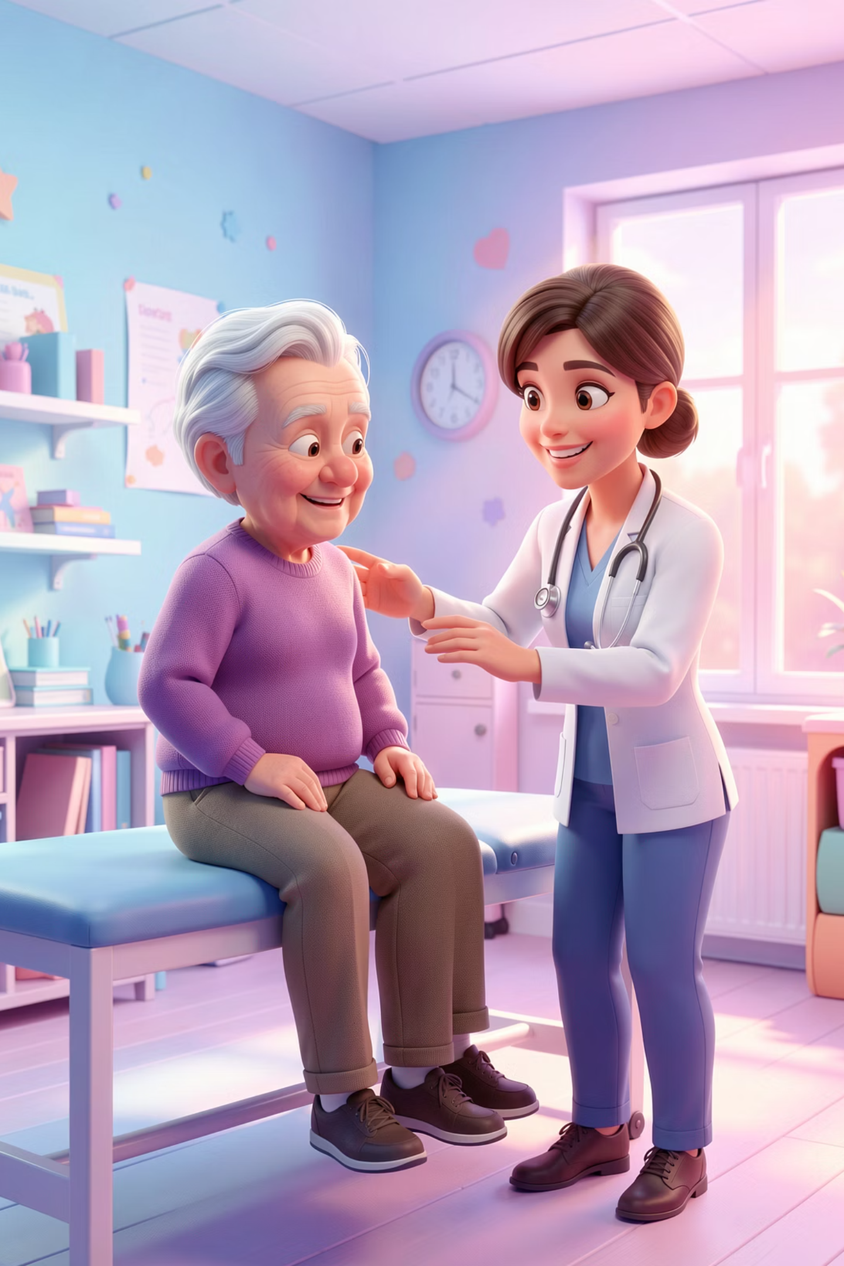
Case Studies 1 & 2
CASE STUDY 1
CASE STUDY 2
OLDER ADULT WITH LOW BACK PAIN & CANCER HISTORY
RADICULAR LEG PAIN & NERVE LESION LOCALISATION (Root vs Peripheral Nerve)
You are a physiotherapist in an MSK outpatient clinic.
A 68-year-old woman presents with low back pain radiating to her right leg.
Conduct an appropriate assessment and outline your management plan.
A 48-year-old florist presents with unilateral calf pain and paraesthesia for 8 weeks.
Assess and explain your diagnosis.
Time: 15 minutes
Time: 15 minutes

Slide 8
Case Studies 3, 4 & 5
CASE STUDY 3
CASE STUDY 4
CASE STUDY 5
CERVICAL, SHOULDER & NEUROLOGICAL PRESENTATIONS (NECK & ARM PAIN – RADICULOPATHY VS MYELOPATHY)
PERSISTENT & INFLAMMATORY LOW BACK PAIN
SHOULDER PAIN, TRAUMA & FROZEN SHOULDER
A 39-year-old builder has 6 months of low back pain disturbing sleep but improving with activity.
A 50-year-old man presents with shoulder pain following a fall 2 weeks ago.
A patient presents with neck pain radiating to the arm and altered sensation.
Perform a focused assessment and outline next steps.
Time: 15 minutes
Time: 15 minutes
Time: 15 minutes

Slide 9
Debrief Framework
Debrief after each case study:
What was missed?
What was your working diagnosis initially?
What was unsafe?
What changed management
What would you do differently on placement?

